Slide 1

TC-CAPSTONE PROJECT EDA ON STUDENT PERFORMANCE Presented by: S.Sravani B.Jayanthi M.Chaitanya S.Priyamvada Guided by: Umamaheswari

Slide 2
CONTENTS
Introduction
Applications
Fundamentals of Python
OOPs in Python
Machine Learning
Statistics
Task: EDA on Students Performance
Problem Statement
System Architecture
Conclusion

Slide 3
INTRODUCTION
Python is a general-purpose interpreted, interactive, object-oriented, dynamically typed and high-level programming language.
It was created by Guido van Rossum during 1985- 1990.
Python is a very easiest programming language with many types of libraries and flexible implementation.

Slide 4
APPLICATIONS
System programming
Graphical User Interface
Web Scrapping
Game development
Robotics
Automation
Data Science
Managing Database

Slide 5
Fundamentals of Python
Fundamentals in python are keywords, Datatypes, Variables, Identifiers.
Python consists of 33 keywords.
Datatypes: int, string, complex, float, Boolean.
Operators are used to perform Mathematical operations in python.
List, Dictionary and sets are mutable whereas Tuple is immutable.
String is a collection of alphabets and strings are immutable.

Slide 6
OOPs in Python
Classes and Objects
Class is nothing but blue print or collection of objects.
Object is instance of class. For eg. Mango is a fruit. Here Mango is an object where as it belongs to fruits, Fruit is a class.
Abstraction, Encapsulation, Polymorphism, Inheritance are the main concepts of Object Oriented Programming.
Abstraction is a way of hiding the unnecessary code details from the user.

Slide 7
Encapsulation is a process of wrapping the data and methods into one unit.
Inheritance is the way of accessing properties of super class or we can say that accessing the properties of parent class.
Polymorphism simply means that representing a single form in many ways.

Slide 8
Machine Learning
Machine learning is the field of study that gives computers the ability to learn without being explicitly programmed.
Types of ML
Supervised learning: This is based on supervision. In this technique we use the labelled dataset. Main goal is to map the input variable with output variable.
Classification and regression problems comes under supervised learning.

Slide 9
Unsupervised learning: In this supervision is not needed. Unlabelled data is used. Machine predicts the output without any supervision.
Semi supervised learning: This lies between Supervised and Unsupervised learning.
This uses the combination of labelled and unlabelled data during the training period.
Reinforcement learning: This is based on feedback based process. Agent is rewarded for good and punished for bad.Agent can be learn through experiences.

Slide 10
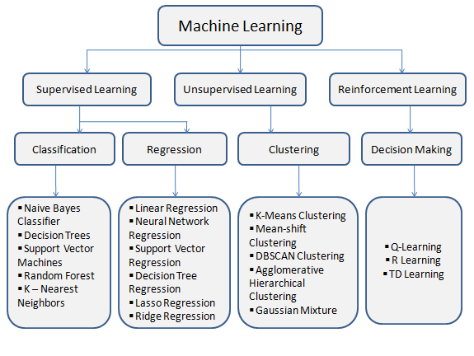

Slide 11
STATISTICS
What is the need of the statistics in ML?
It helps to analyze and visualize data to find unseen patterns.
Statistics deals with collecting, analyzing, interpreting and visualizing data.
Population and Sample: Population comprises all observations. Sample is a subset of population.
Measures of central tendency: Mean, Median and mode.

Slide 12
Variance and Standard deviation: Variance is used to measure the variability in the data from mean. Standard deviation is the square root of variance. However both represents the measures of it.
Skewness and kurtosis: Skewness measures the shape of the distribution. Kurtosis is used to check whether the tails of a given distribution have extreme values.

Slide 13
Libraries in ML
Pandas: Pandas is used to read the data which is in the format of .csv, .xml. It mainly works with relational or labelled data.
Numpy: It is used for mathematical computations in machine learning.
Matplotlib: It is a plotting library for creating static and interactive visualizations in python.
Scikit-learn: It features various classification, regression and clustering algorithms.

Slide 14
Task: EDA on students performance
Problem statement:
To understand how the student's performance (test scores) is affected by the other variables (Gender, Ethnicity, Parental level of education, Lunch, Test preparation course).

Slide 15
System Architecture
DATA COLLECTION
DATA PREPROCESSING
DATA
VISUALIZATION

Slide 16
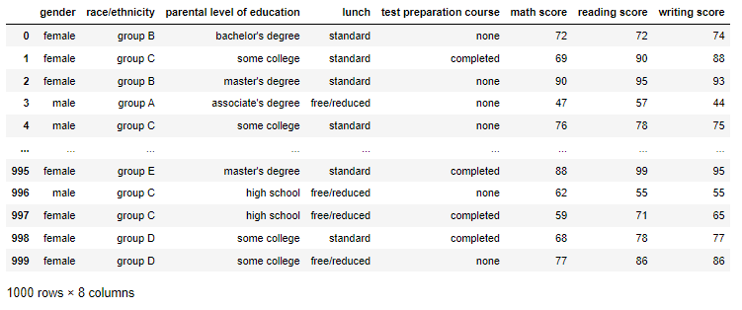
Output Screens
Reading the dataset.
Dataset link: www.kaggle.com

Slide 17
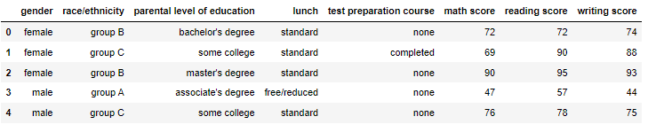
Reading first five values of dataset.

Slide 18
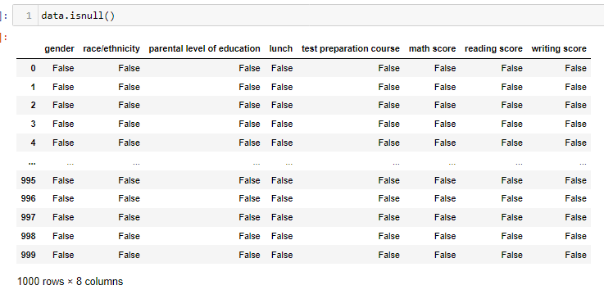
Checking whether there are any missing values in the dataset.

Slide 19
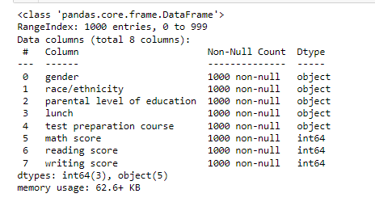
Another way to check missing values using .info() method

Slide 20
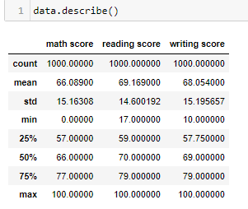
Here we depict the statistical values mean, std, count of given dataset.

Slide 21
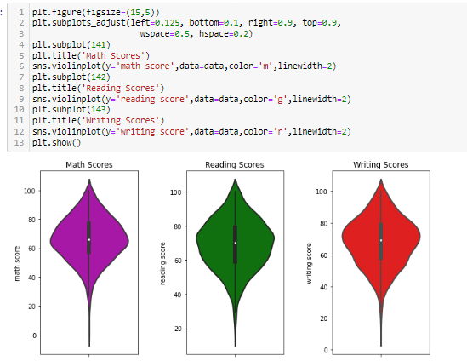
From the below graph we can see that the maximum number of students have scored 60-80 in all three subjects i.e., math, reading and writing.

Slide 22
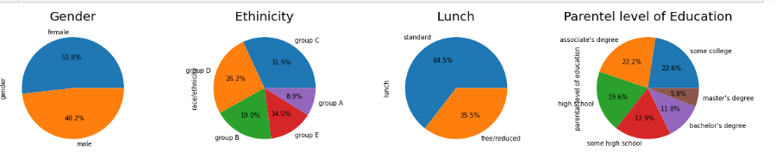
Proportion of remaining variables
From the above observations we can say that:
The proportion of male and female are almost same
Highest number of students belong to Group C ethnicity followed by Group D
Highest proportion of the students have standard lunch
Highest proportion of parental level of Education is 'Some college', 'associate's degreee' and 'high school'

Slide 23
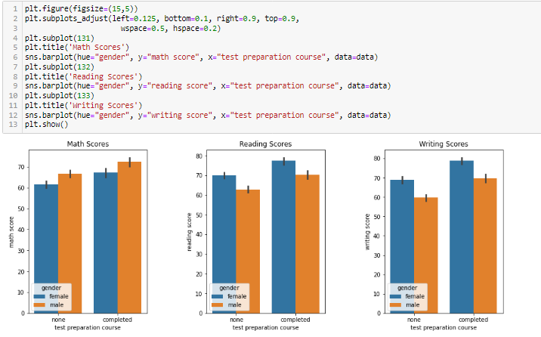
Scores who completed Test preparation course So the students (male and female) who completed the test preparation course scored higher in all three subjects.

Slide 24
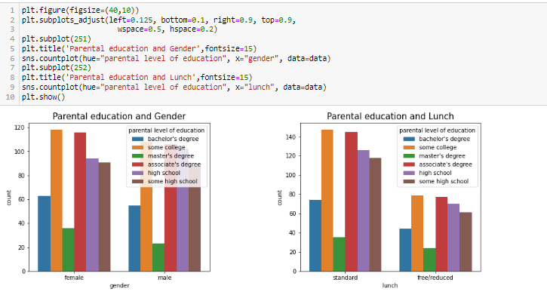
By the below graphs we can say that no. of female and male are high when parental education is some college. And lunch is standard and free for some college of parental education.

Slide 25
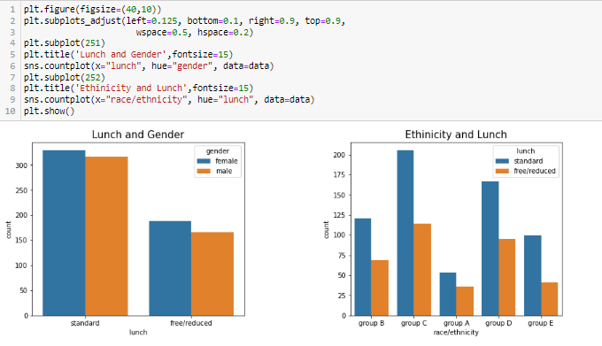
In case of lunch and gender females are high in standard and free/reduced and male are less in standard and reduced.In case of ethnicity and lunch we can say that group c has standard lunch and group a has free/reduced.

Slide 26
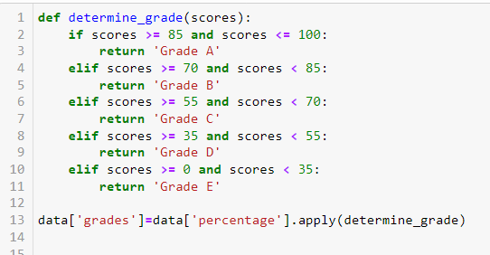

Slide 27
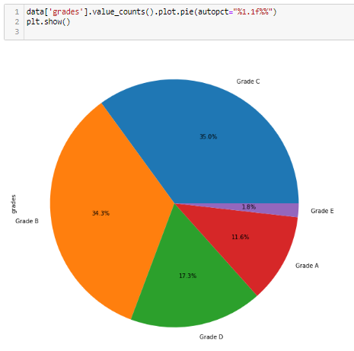
Most of the students got Grade B and Grade C.

Slide 28
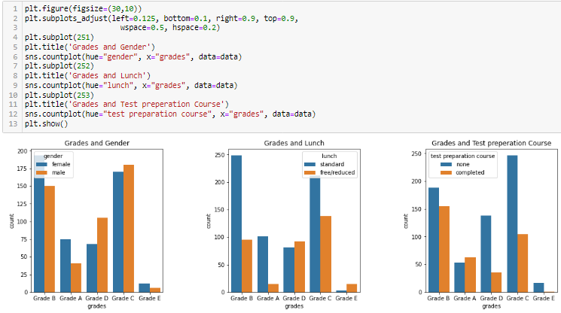
In case of grades and gender most of the male and female got grade c.
In case of grades and lunch students who have standard lunch got grade B and who have free got grade c.
In case of grades and test preparation course students who have completed the test course got grade B and those who have not completed got grade C.

Slide 29
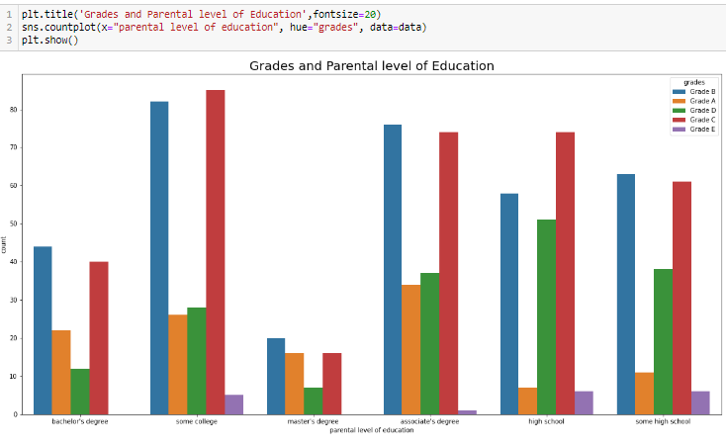
Grades and Parental level of Education.

Slide 30
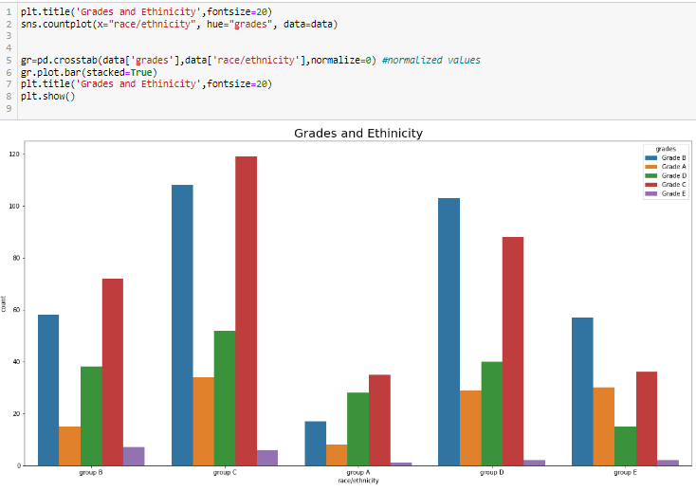

Slide 31
Conclusion

